Slide 1
A
Seminar
on
“Hand Written Digit Recognition using Machine Learning”
Group Members :
- Vivek Vinayak Bidgar
- Jadhav Rinku Gopal
- Lodhavat Amey Vijaysingh
- Patil Kunal Dnyandev
-
Guided by
Prof. Kanchan Dhomse
AY 2020-21

Slide 2
Outline of Presentation
Introduction
Motivation
Objective
Literature Survey
Implementation
Applications
Summary
References

Slide 3
Introduction
The ability of computers to recognize human handwritten digits is referred to as handwritten digit recognition. Handwritten digits are not perfect and can be made in any shape as a result, making it a tedious task for machines to recognize the digits. So in this, we will use the image of the digit and recognize the digit present in that image.
We are using a Scikit-learn to train our model.
We are not using any pre-collected images of digit. But we will predict images live drawn in paint, so for this we have to collect images from paint by our own.

Slide 4
Motivation
The general problem we predicted we would face in this digit classification problem was the similarity between the digits like 1 and 7, 5 and 6, 3 and 8, 9 and 8 etc. Also people write the same digit in many different ways ‐ the digit ‘ 1 ’ is written as ‘ 1 ’, ‘1’ ’ , or ‘ 1 ’. Similarly 7 may be written as ‘ 7 ’, ‘ 7 ’, or ‘ 7 ’.
Our goal was to implement a pattern classification method to recognize the handwritten digits provided in the MNIST data set of images of hand written digits (0‐9).

Slide 5
Objective
To recognize handwritten digits correctly.
To improve the accuracy of detection.
To develop a method which is independent of digit size and writer style/ink independent.

Slide 6
About Dataset
We will be using MNIST dataset which is very famous or we can say it is very popular among machine learning and deep learning enthusiasts. In this dataset, there are 60,000 training images of handwritten digits from zero to nine and 10,000 images for testing. So in this, we have 10 different classes. In this, the images are represented as a 28 x 28 matrix where each cell contains grayscale pixel value.
But in this project we will be predict images live drawn in paint software.

Slide 7
We used following libraries:
1. Scikit learn
2. Open CV
3. Tensorflow
4. keras
5. tkinter
6. Pandas

Slide 8
About Scikit-learn
Scikit-learn is probably the most useful library for machine learning in Python.
The sklearn library contains a lot of efficient tools for machine learning and statistical modeling including classification, regression, clustering and dimensionality reduction.

Slide 9
Open- CV
The use of open cv is to convert images into grayscale images.
OpenCV (Open Source Computer Vision Library) is an open source computer vision and machine learning software library. OpenCV was built to provide a common infrastructure for computer vision applications and to accelerate the use of machine perception in the commercial products. Being a BSD-licensed product, OpenCV makes it easy for businesses to utilize and modify the code.

Slide 10
keras

Slide 11
SVC Model
We used Support Vector Classifier algorithm for classification.
Support Vector Classifier (SVC) method applies a kernel function to perform classification and it performs well with a large number of samples.
SVC is a nonparametric clustering algorithm that does not make any assumption on the number or shape of the clusters in the data. In our experience it works best for low-dimensional data, so if your data is high-dimensional, a preprocessing step, e.g. using principal component analysis, is usually required.

Slide 12
Literature Survey
Sr. No. | Author | Title | Publication | Year | Implementation | Challenges
1. | Anchit Shrivastava Isha Jaggi Sheifali Gupta Deepali Gupta | Handwritten Digit Recognition Using Machine Learning : A Review | IEEE | 2019 | In this paper, various methods for handwritten numeral recognition based on MNIST database are compared. | In this paper with increase the number of layers of the system, the accuracy as well as the computational time increase's
2. | Fathma Siddique Shadman Sakib Md. Abu Bakr Siddique | Recognition of Handwritten Digit using Convolutional Neural Network in Python with TensorFlow and Comparison of Performance for Various Hidden Layer | IEEE | 2019 | In this paper, the variations of accuracies for handwritten digit were observed for 15 epochs by varying the hidden layers. | Overfitting - neural networks overfit to the training set very easily.

Slide 13
Literature Survey
Sr. No. | Author | Title | Publication | Year | Implementation | Challenges
3. | Jinze Li Gongbo Sun Leiye Yi Qian Cao Fusen Liang Yu Sun | Handwritten Digit Recognition System Based on Convolutional Neural Network | IEEE | 2020 | This paper designs a handwritten digit recognition system based on convolutional neural network. The system adopts the method of deep learning and uses the MNIST data set as a training sample. | The design in this article has problem of too long recognition time..
4. | Rohan Sethi Ila Kaushik | Hand Written Digit Recognition using Machine Learning | IEEE | 2020 | KNN algorithm to solve the problem of Hand-Written Digit Classification; the dataset used to solve the problem is referred to as the MNIST dataset and Feature Extraction using PCA | Accuracy depends on the quality of the data.

Slide 14
Implementation
We divided implementation in four parts.
Screen Capture
Generate dataset and Load it
Fit the model using SVC and calculate accuracy
Prediction of image drawn in paint & converting our project in GUI.

Slide 15
Implementation
Screen Capture
We have to collect images of digits (from 0 to 9). To collect images, pyscreenshot package can be used.
This package can be downloaded using pip which is a package management tool that are written in python and used to install python packages.

Slide 16
import pyscreenshot as ImageGrab # imagegrab is a notation you can use any notation.
import time
images_folder="captured_images/0/" #this is the path of your folder for images
for i in range(0,100):
time.sleep(8)
im=ImageGrab.grab(bbox=(60,170,400,550)) #x1,y1,x2,y2 #region of screen to capture
print("saved......",i) #display msg
im.save(images_folder+str(i)+'.png') #im is variable
print("clear screen now and redraw now........") #display msg

Slide 17
Implementation
2)Generate dataset and Load it
We generated our dataset using images that we have collected in 1st step. To generate dataset, we assign 1 to the drawn region and 0 to the background. That means, in our dataset, we will be having only two values i.e., 0 and 1.
Pixel value ranges from 0 to 255. Typically, 0 represent black and 255 represent white. We will assigning 0 to pixel value from 0 to 100 and 1 to pixel value from 100 to 255. Now our pixel value is not from 0 to 255, it is only 0 and 1. In this way, We will generating dataset (csv file).
Final step is to open the dataset, shuffle it i.e., change the position of each row of data and display it.

Slide 18
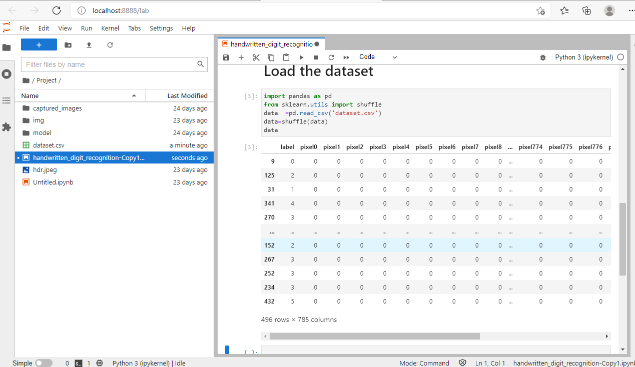
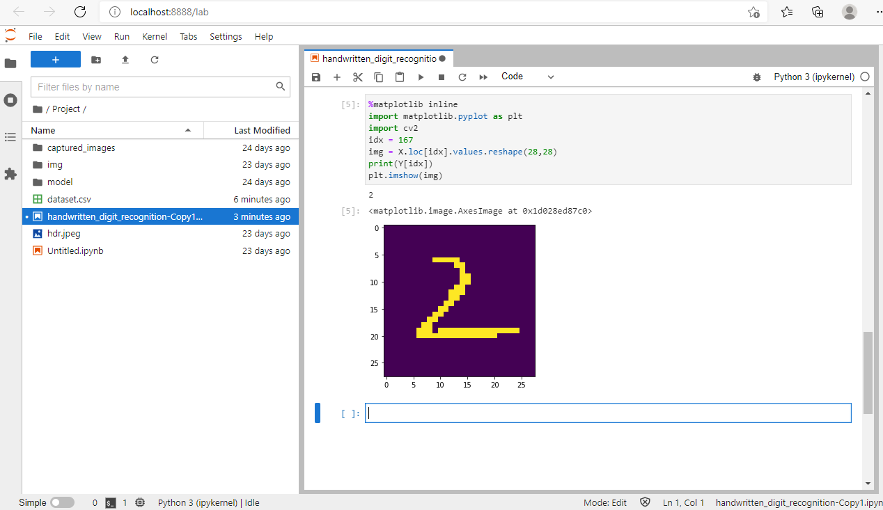
Implementation
Fig: Loaded Dataset Fig. Visualization using matplotlib

Slide 19
Implementation
3)Fit the model using SVC and calculate accuracy
We have to train our model and calculate the accuracy. For this, we separate dependent (Y) and independent variable (X). Our independent variable will be the pixel value (i.e. 0 and 1). Remember, each digit is represented by huge number of 0 and 1. And our dependent variable will be our digit (i.e. from 0 to 9).
We used scikit-learn to train our model.

Slide 20
Implementation
4) Prediction of image drawn in paint & converting our project in GUI.
We have to predict digit drawn in paint. Now, we didn’t provide 20% images (testing images) to our model but we provide new images. We draw digit in paint and at the same time, pass that digit to model, our model has to predict that digit.

Slide 21
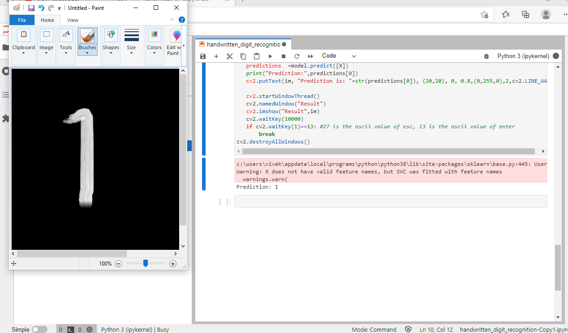
Result
As you can see in the image our model perfectly predict the image.

Slide 22
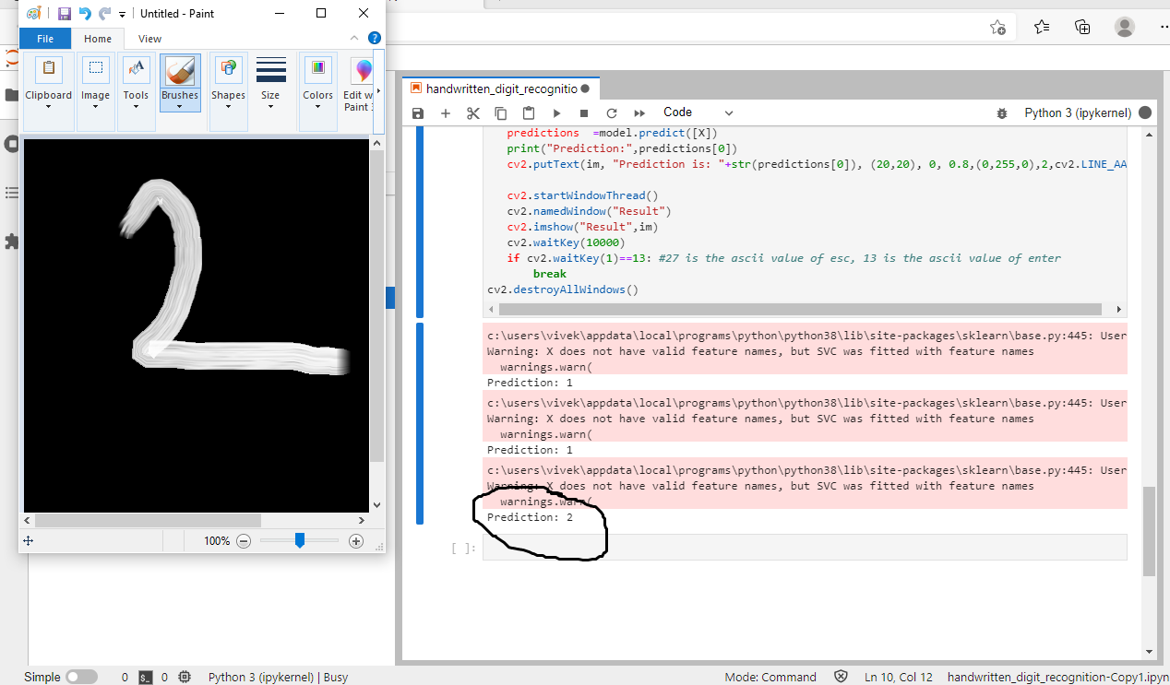
Result

Slide 23
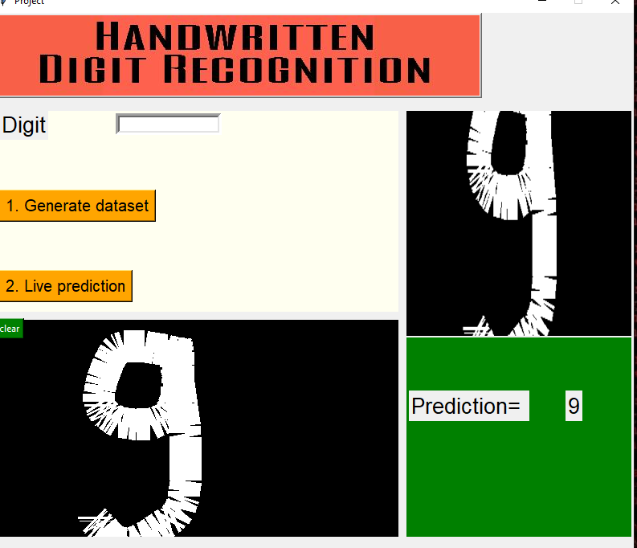
Result
This is the final GUI output of our project. As you can see in the image on left hand side where you have to draw the image & click on the live prediction button then it will give output on right side window.

Slide 24
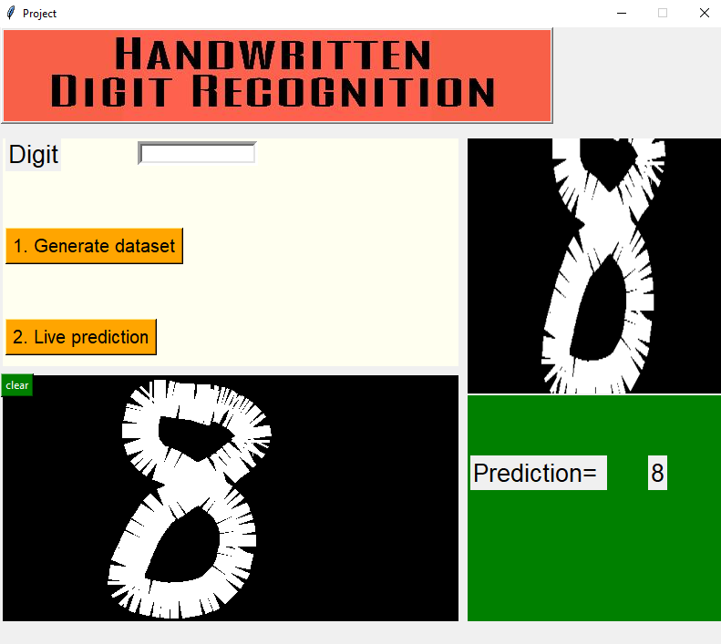
Result

Slide 25
Applications
The main areas of application of this supervised machine learning algorithm are data compression, genetic analysis and many more.
Handwritten Digit Recognition is used to recognize the digits which are written by hand
A handwritten digit recognition system is used to visualize artificial neural networks
It is already widely used in automatic processing of bank cheques, postal addresses, in mobile phones etc.

Slide 26
Scope
• Postal mail sorting
• Courtesy amounts on cheques
• Formation of data entry etc.

Slide 27
Summary
We have successfully built our own dataset.
We can also use free dataset from internet.

Slide 28
References
[1] Rohan Sethi1 , Ila Kaushik2 , “Hand Written Digit Recognition using Machine Learning ,” 9th IEEE International Conference on Communication Systems and Network Technologies
[2] Wenfei Liu, Jingcheng Wei, Qingmin Meng, “Comparisions on KNN, SVM, BP and the CNN for Handwritten Digit Recognition,” 2020 IEEE International Conference on Advances in Electrical Engineering and Computer Applications (AEECA) .
[3] 1Anchit Shrivastava 2Isha Jaggi 3Sheifali Gupta 4Deepali Gupta, “Handwritten Digit Recognition Using Machine Learning : A Review ,” 2nd International Conference on Power Energy, Environment and Intelligent Control (PEEIC) G. L. Bajaj Inst. of Technology and Management Greater Noida, U. P., India, Oct 18-19, 2019.
[4] Handwritten Digit Recognition using Machine Learning | by Himanshu Beniwal | Medium

Slide 29
THANK YOU

